Slide 1
Measuring Matter Antimatter Asymmetries at the LHC
Euan Baldwin & Luca Vicaria

Slide 2
Aims
Objectives
To utilise and understand data analysis techniques used in modern particle physics experiments.
To understand how matter antimatter differences can be observed.
To understand the design of a particle physics detector.
To write a Python program to select and analyse three-body decays of charged B mesons.
To use the data to observe intermediate resonance states in the decays.
To use the data to observe matter antimatter differences.

Slide 3
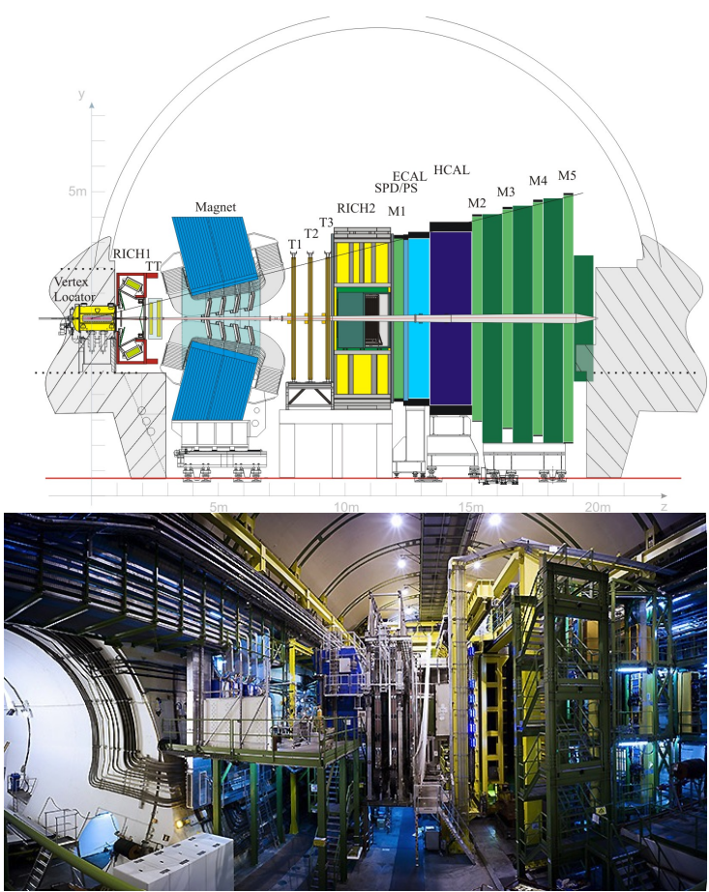
The Setup
Vertex locator
Magnet
Tracking stations: TT, T1, T2, T3
Rich detectors
ECAL, HCAL, SPD, PS
Muon detectors: M1, 2, 3, 4, 5

Slide 4
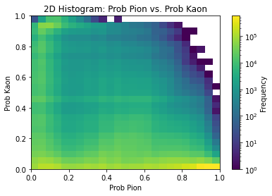
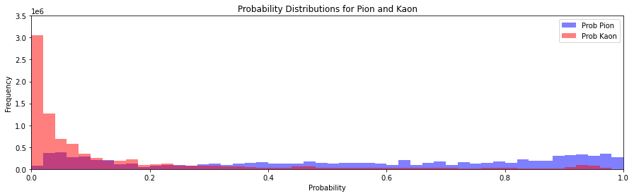
Classification

Slide 5
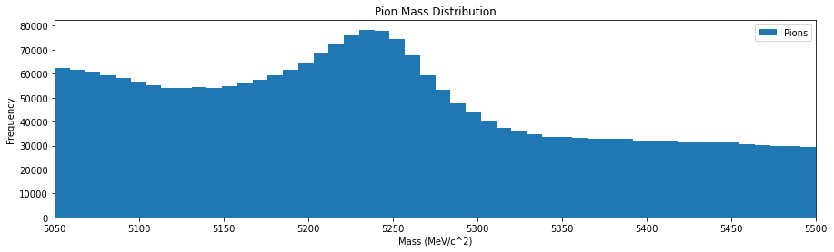
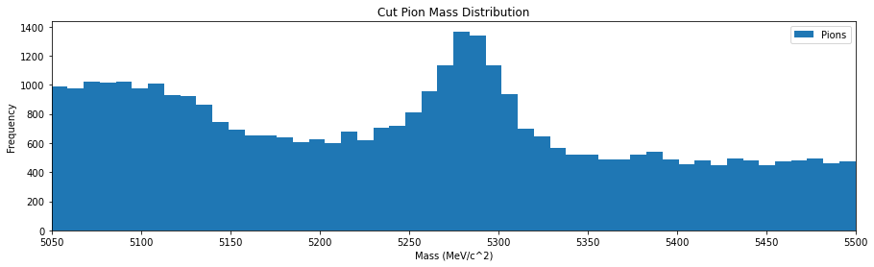
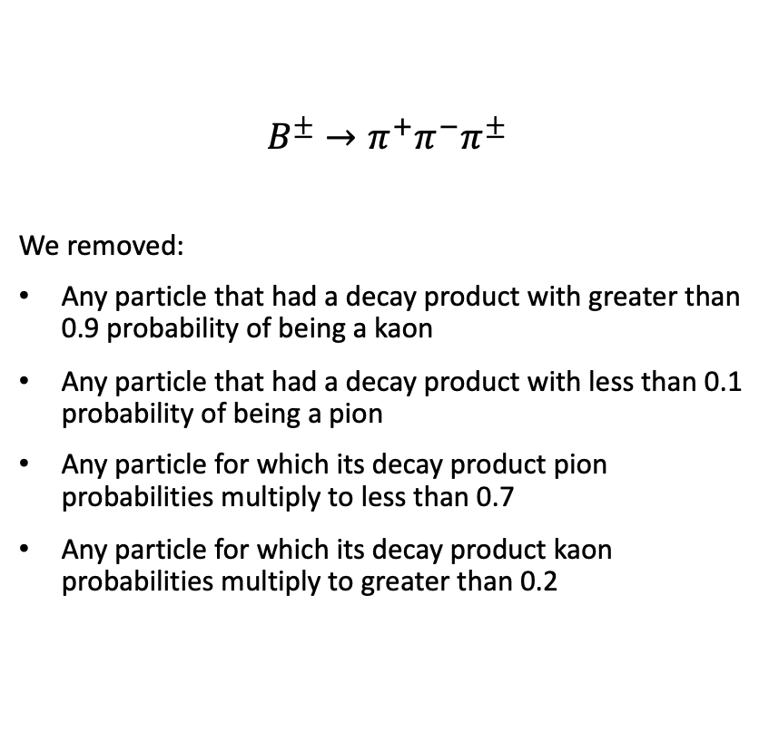
Selection
$$B^{±}→π^{+}{π^{−}π}^{±}$$
We removed:
Any particle that had a decay product with greater than 0.9 probability of being a kaon
Any particle that had a decay product with less than 0.1 probability of being a pion
Any particle for which its decay product pion probabilities multiply to less than 0.7
Any particle for which its decay product kaon probabilities multiply to greater than 0.2

Slide 6
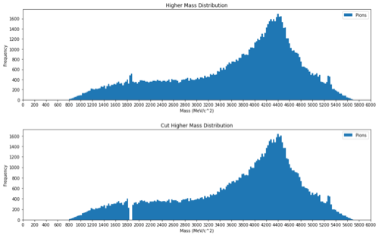
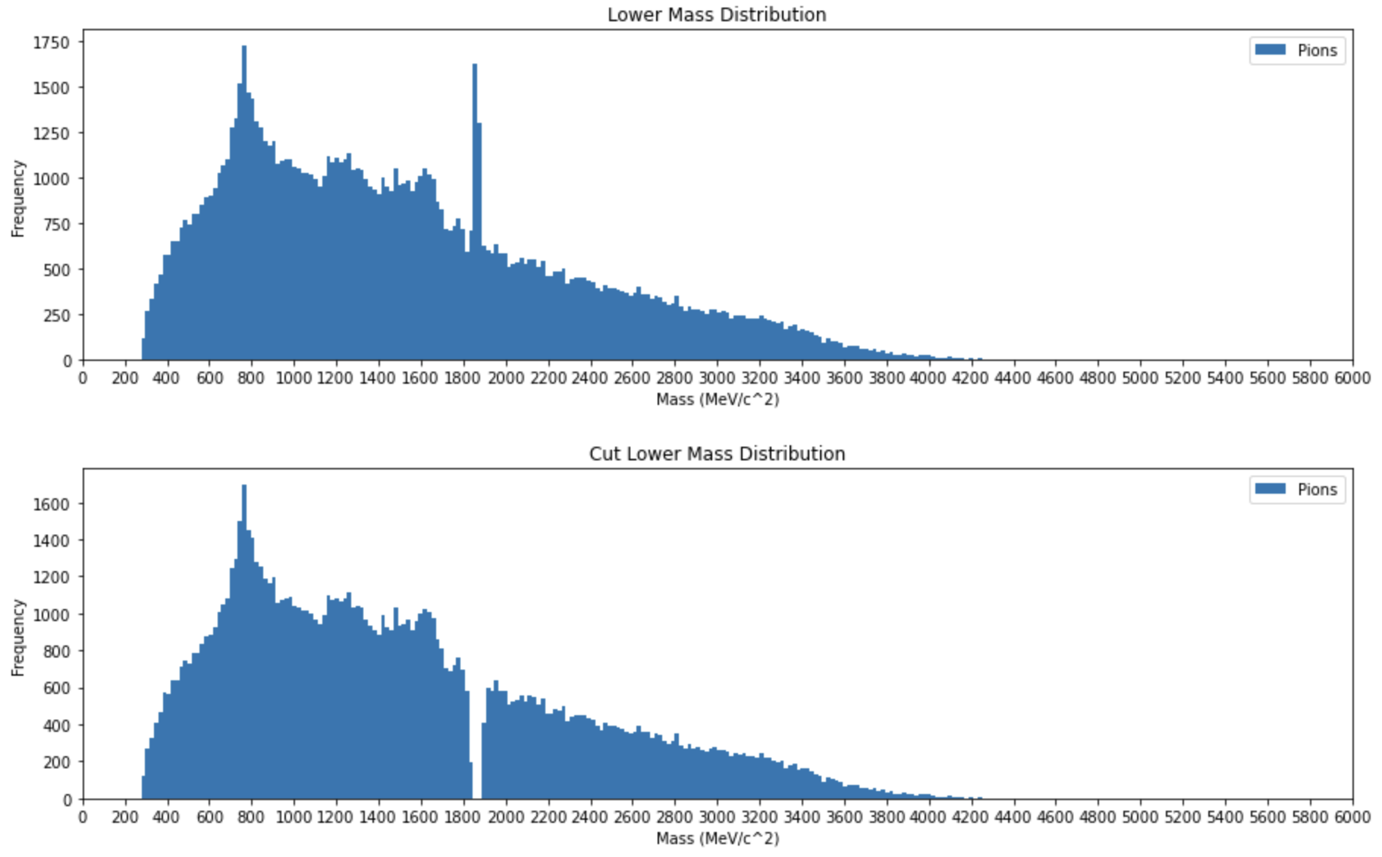
Two-body Resonance

Slide 7
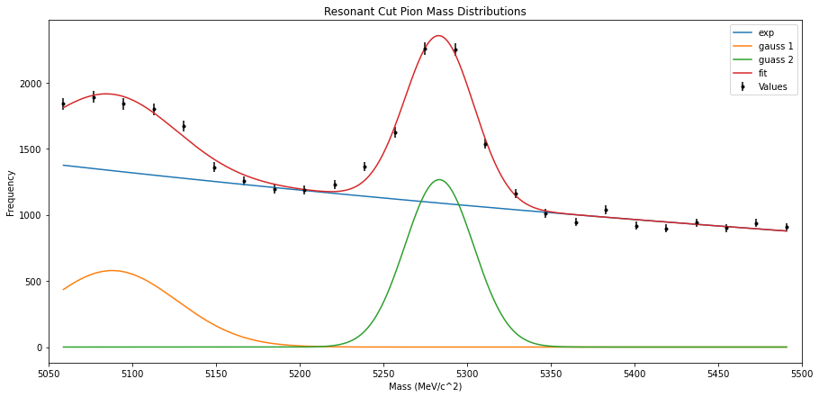

Fitting
$$χ_{R}^{2}=1.88$$

Slide 8
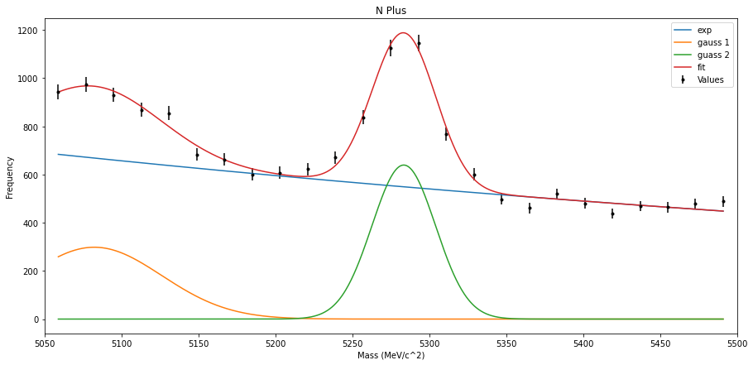
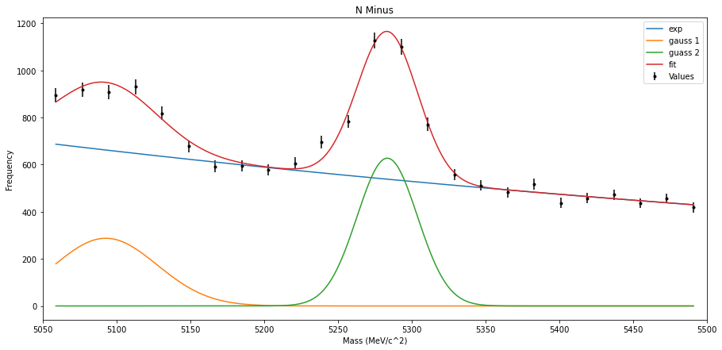
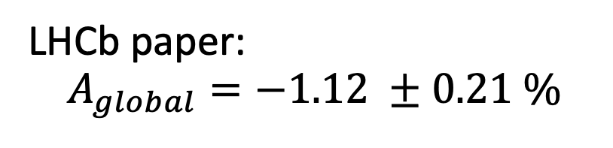
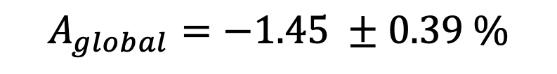
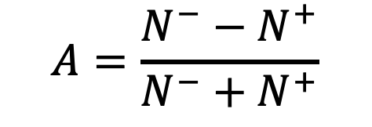


Global CP Asymmetry
$$χ_{R}^{2}=1.66$$
$$A=\frac{N^{−}−N^{+}}{N^{−}+N^{+}}$$
$$A_{global}=−1.45 ±0.39 \%$$
$$χ_{R}^{2}=1.70$$
LHCb paper:
$$A_{global}=−1.12 ±0.21 \%$$

Slide 9

Uncertainty
$A=\frac{N^{−}−N^{+}}{N^{−}+N^{+}}= ε_{1}− ε_{2}, where{ ε}_{1}= \frac{N^{−}}{N^{−}+N^{+}}$, ${ ε}_{1}= \frac{N^{+}}{N^{−}+N^{+}},$So that $ε_{1}+ ε_{2}=1$
$$σ_{ε_{1}= }\sqrt{npq}= \frac{\sqrt{ε_{1}ε_{2}N}}{N}=\sqrt{\frac{ε_{2}(1−ε_{2})}{N}}=σ_{ε_{2} }, p= ε_{1}, q=ε_{2}$$
$A= ε_{1}− ε_{2}$ = 1 - 2$ε_{2}$
$1 − A^{2}=1 −{\left(1 −2ε_{2}\right) }^{2}=4$ $ε_{2}(1 −ε_{2})$
$$σ_{ε_{1} }=\sqrt{\frac{1−A^{2}}{4N}}=\frac{1}{2}\sqrt{\frac{1−A^{2}}{N}}$$
$$σ_{A}=2σ_{ε_{1} }$$
$∴$ $σ_{A}= \sqrt{\frac{1 −{ A}^{2}}{N^{+} + N^{−}}}$

Slide 10
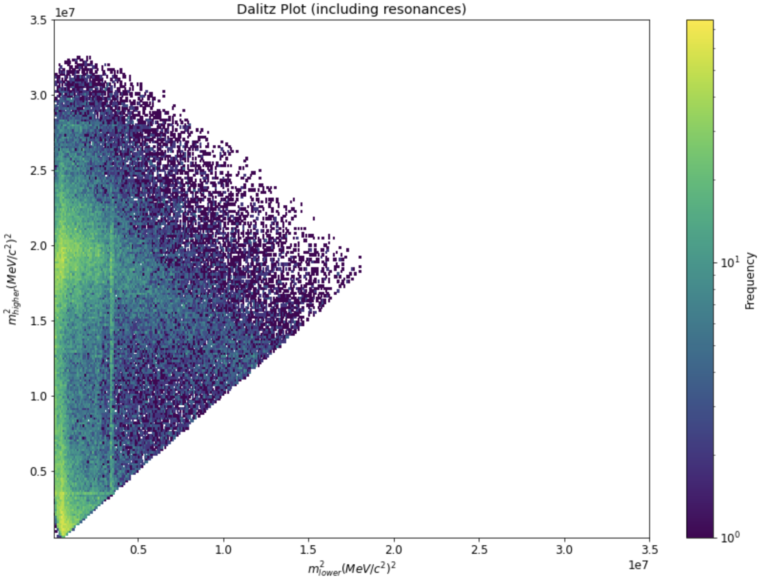
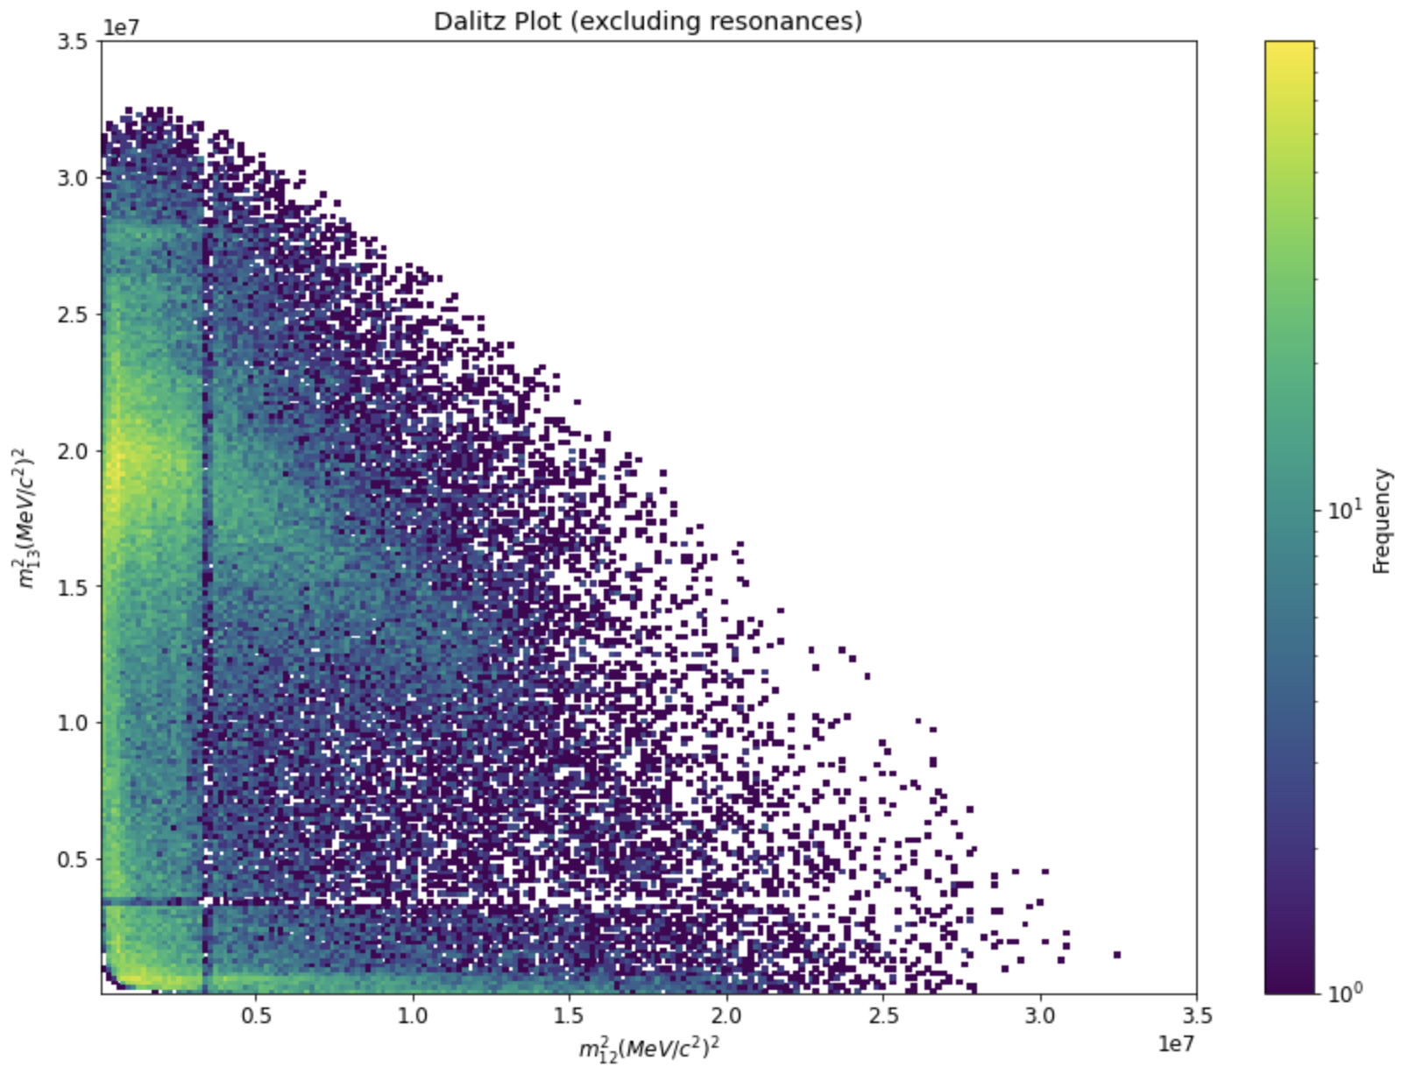
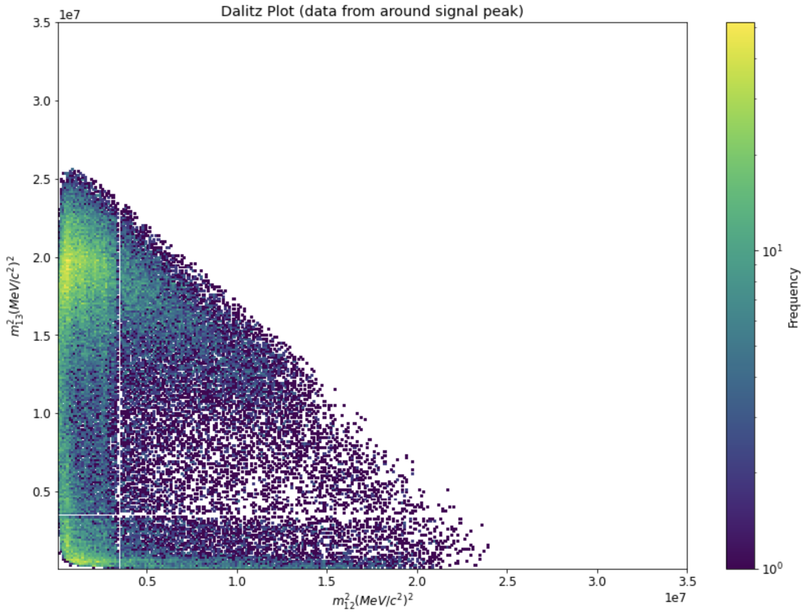
Dalitz Plots

Slide 11
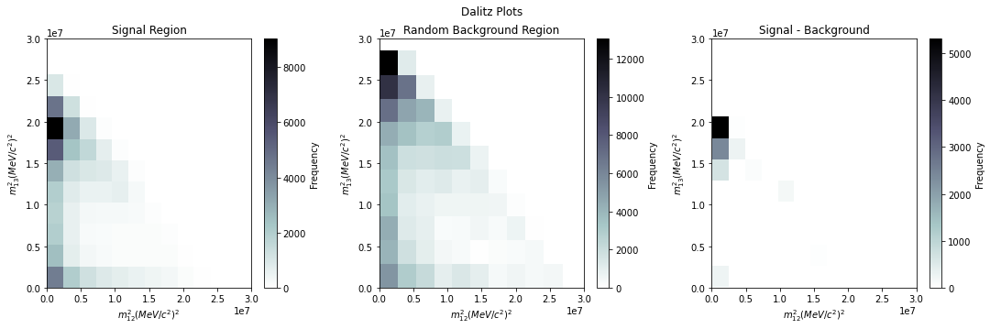
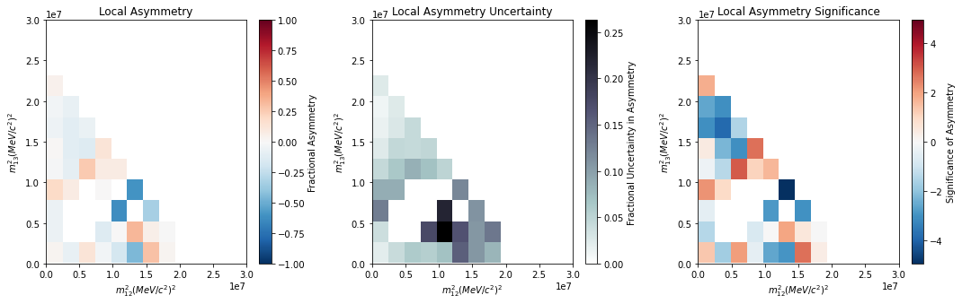
Local CP Asymmetry

Slide 12
Further Work

Slide 13
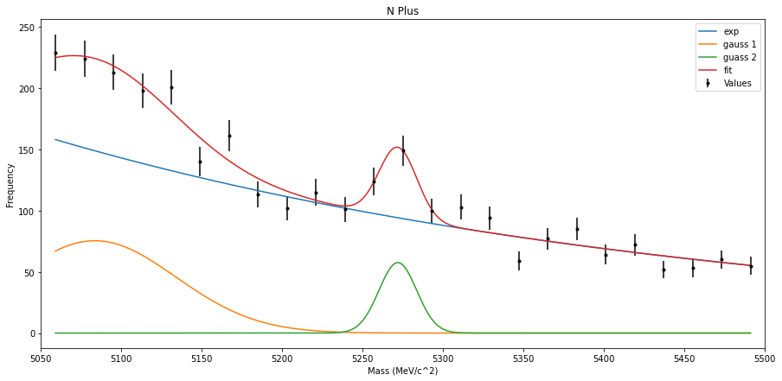
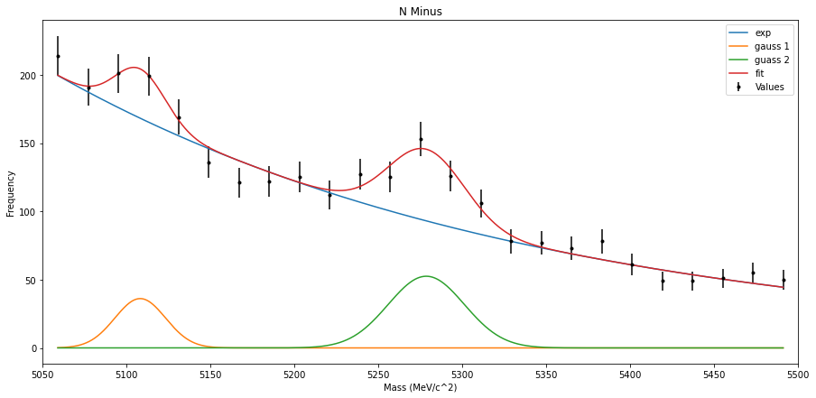



Local CP Asymmetry
$$χ_{R}^{2}=1.63$$
$$χ_{R}^{2}=0.77$$
$$A_{local}=\left(27.6±1.4\right)\%$$

Slide 14

Magnet Orientation Systematic Uncertainty
$$A_{mag}=−(2.61±0.41)\%$$
$$A_{global}=−(1.45±0.39)\%$$
$$A_{systematic, magnet}=1.16\%$$

Slide 15
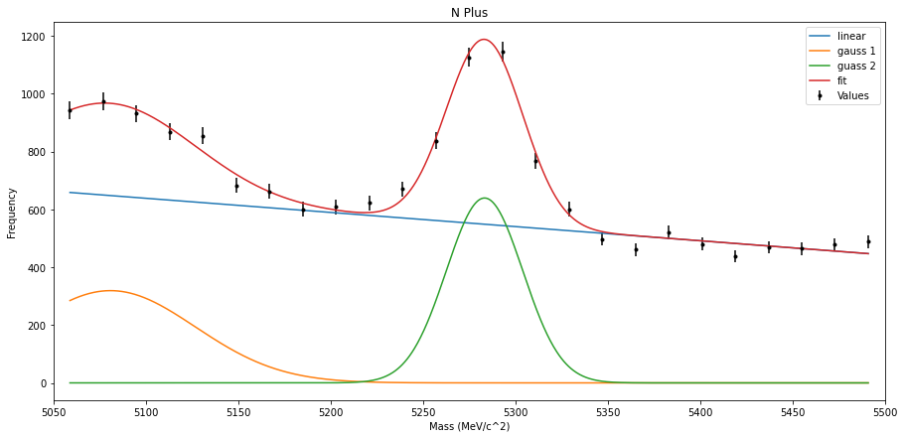
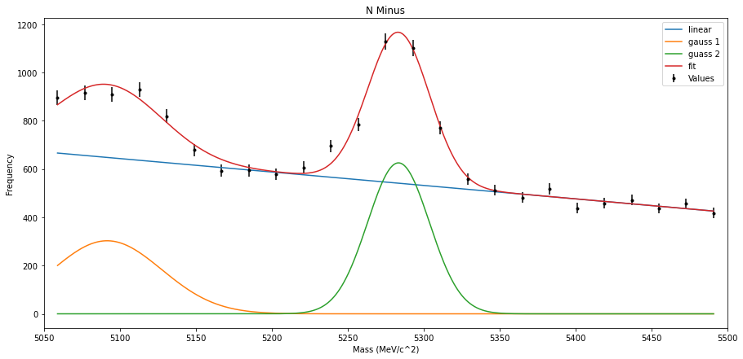
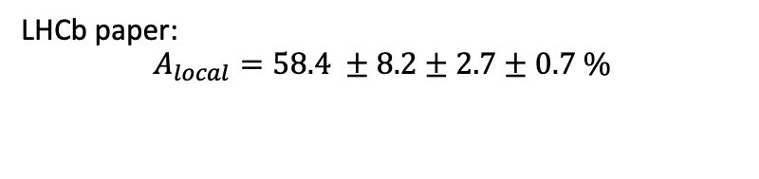


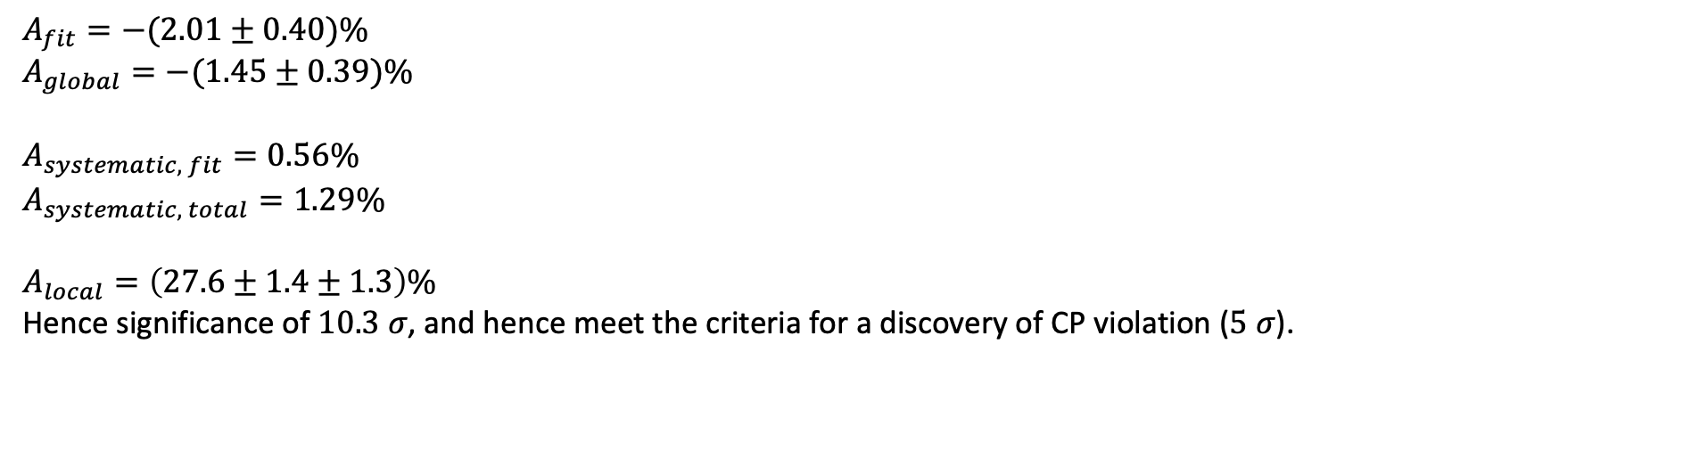
Fitting Systematic Uncertainty
$$χ_{R}^{2}=1.73$$
$$χ_{R}^{2}=1.71$$
$$A_{fit}=−(2.01±0.40)\%$$
$$A_{global}=−(1.45±0.39)\%$$
$$A_{systematic, fit}=0.56\%$$
$$A_{systematic, total}=1.29\%$$
$$A_{local}=\left(27.6±1.4±1.3\right)\%$$
Hence significance of $10.3 σ$, and hence meet the criteria for a discovery of CP violation ($5 σ$).
LHCb paper:
$$A_{local}=58.4 ±8.2±2.7±0.7 \%$$

Slide 16
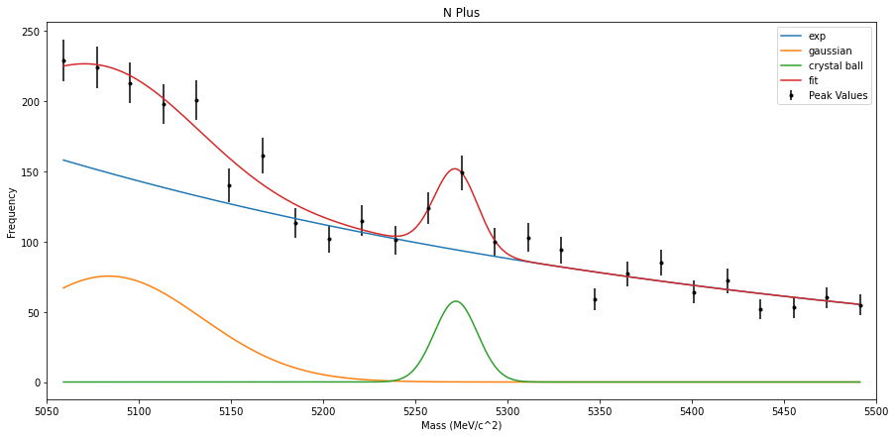
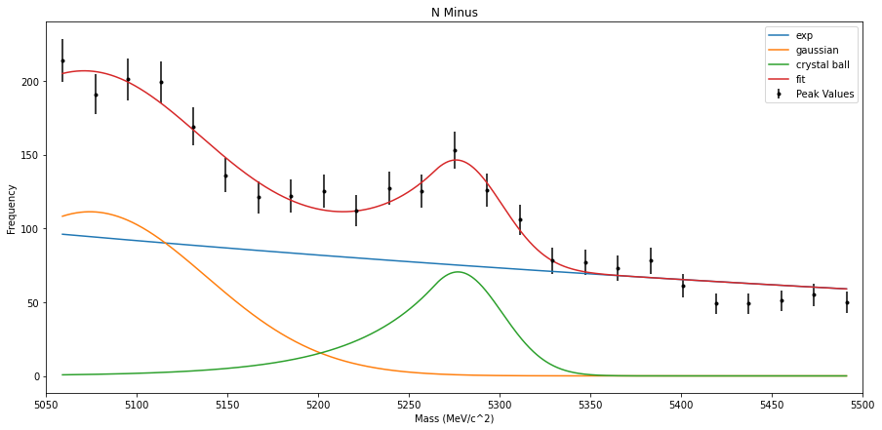


The Crystal ball Function
$$χ_{R}^{2}=1.84$$
$$χ_{R}^{2}=1.41$$
$$A_{local, cb}=(54.5±1.2±1.3)\%$$

